Slide 1



Today's Agenda
Class - 03
01
IF… Else
01
05
Nested If
Pass Statemen
With If….Else
Short Hand If, and, or
02
06
Let’s Build a guessing Game.
Short Hand If
03
07
Short Hand If…Else
04
08
P.P – 4.14

Slide 2
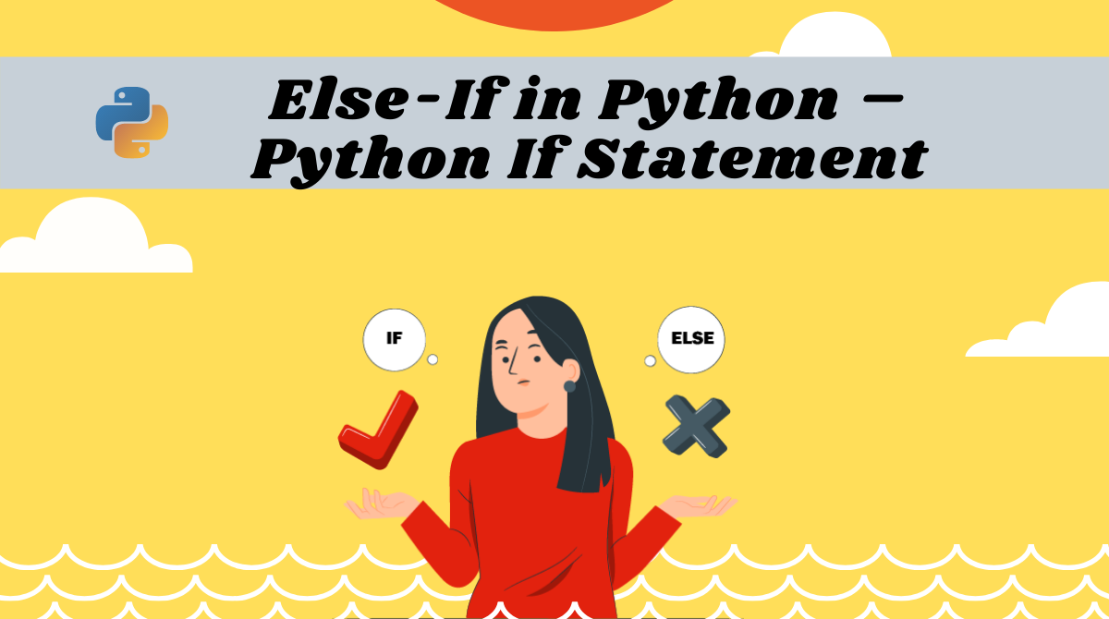

Slide 3
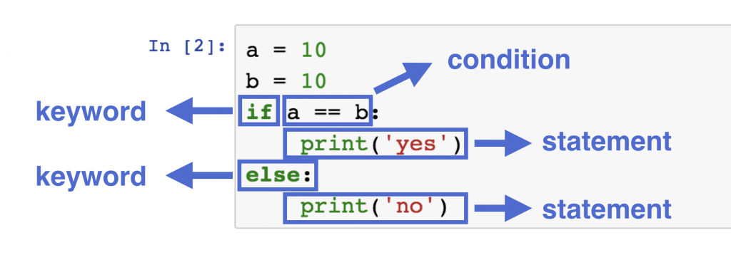
Python If…Else Syntax
03

Slide 4
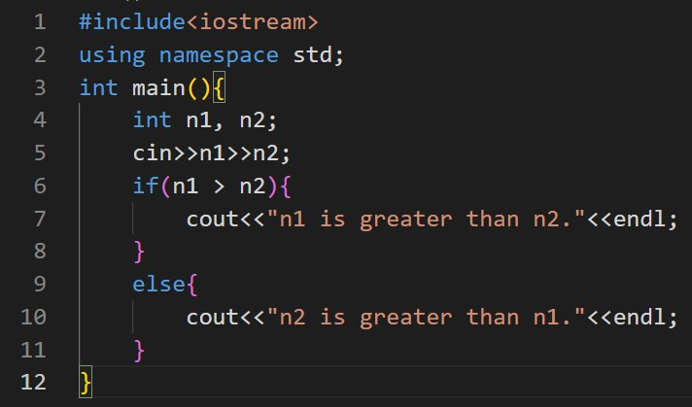
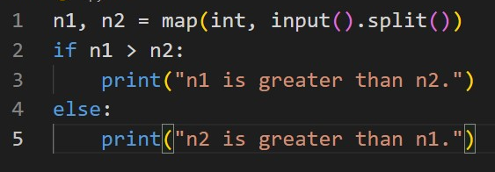
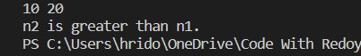
Python If…Else
03

Slide 5
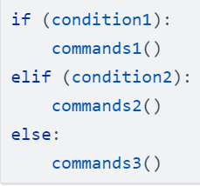
Python elif
03

Slide 6

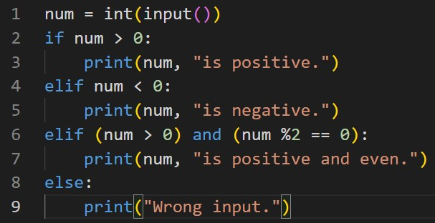
Python If…Else – elif, and , or
04

Slide 7
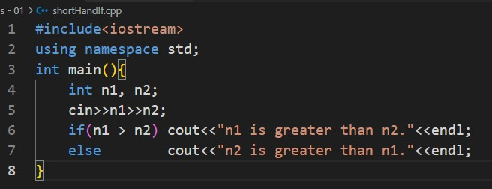
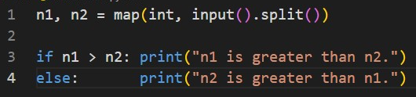
Short Hand If…Else
05

Slide 8
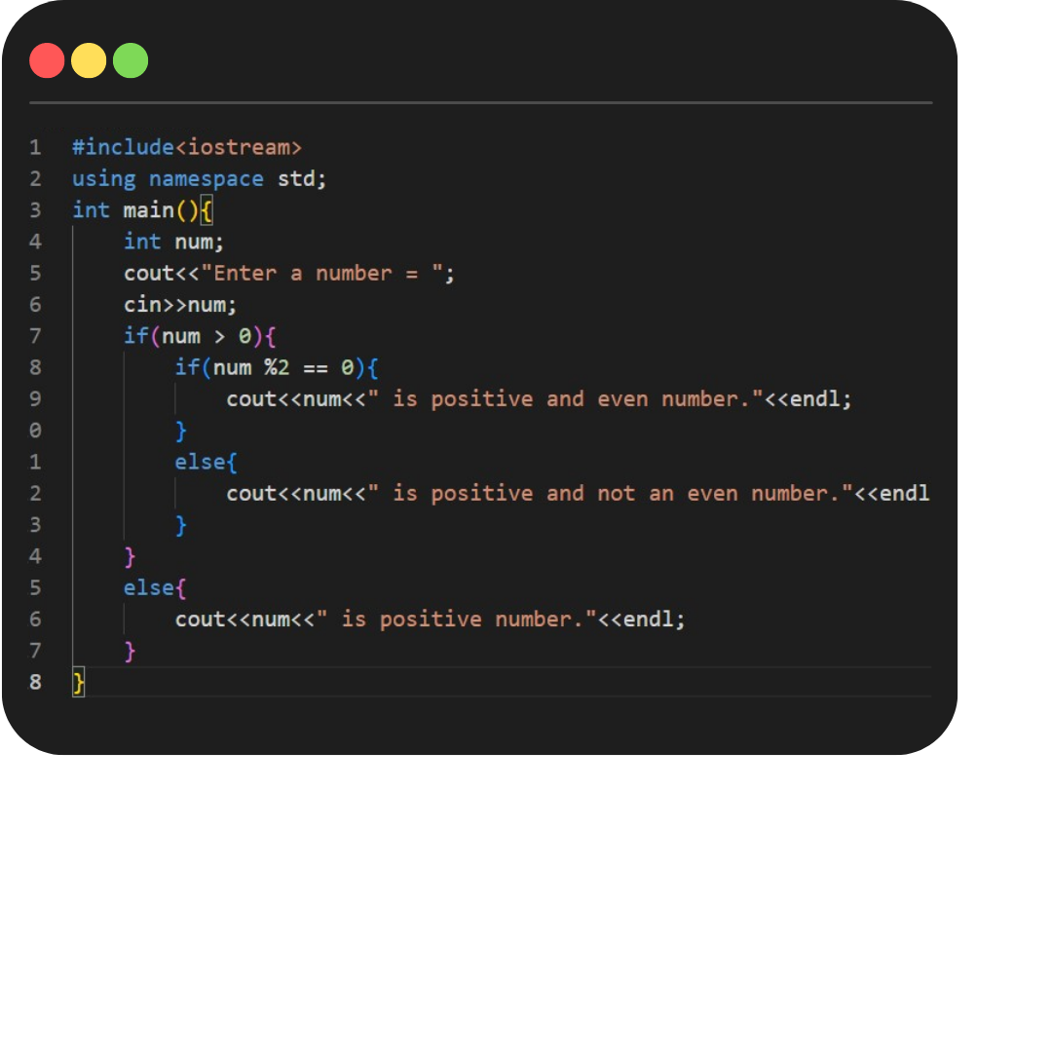
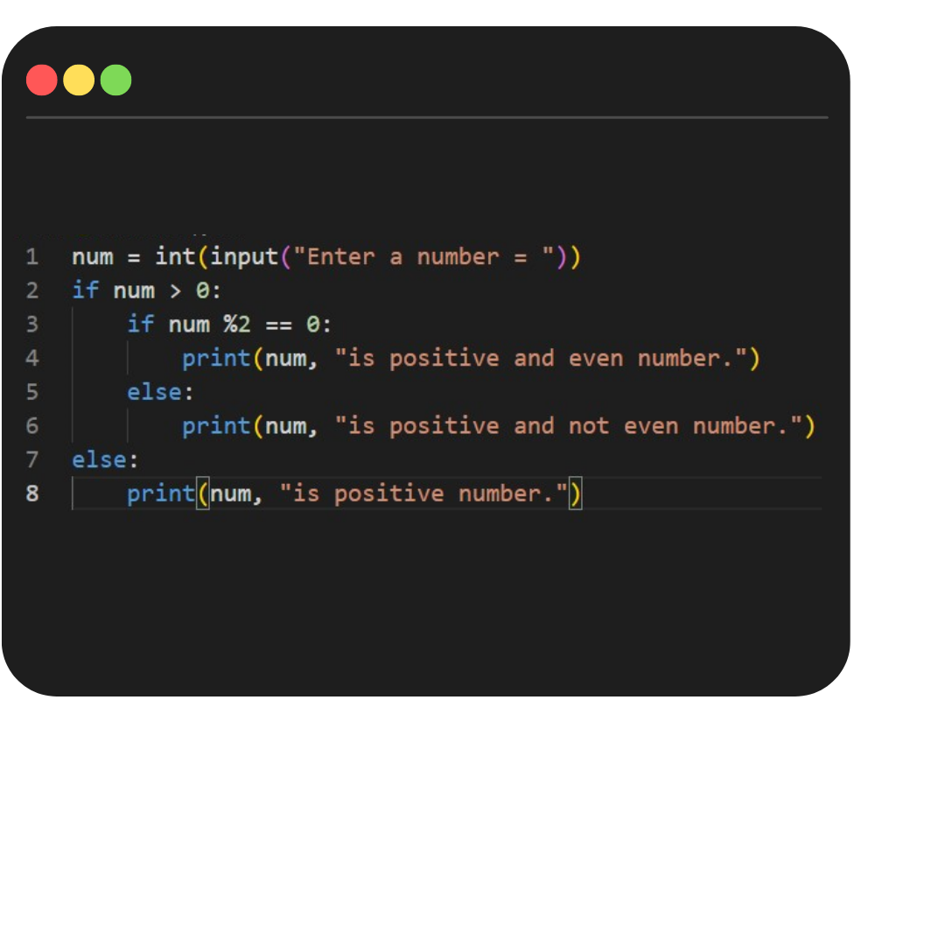
Nested If…Else
06

Slide 9

Practice Problem – 4.14
07
1
Write a program to find maximum between two numbers.
8
Write a program to input any alphabet and check whether it is vowel or consonant.
2
Write a program to find maximum between three numbers.
9
Write a program to input any character and check whether it is alphabet, digit or special character.
Write a program to check whether a number is negative, positive or zero.
10
Write a program to check whether a character is uppercase or lowercase alphabet.
3
4
Write a program to check whether a number is divisible by 5 and 11 or not.
5
Write a program to check whether a number is even or odd.
6
Write a program to check whether a year is leap year or not.
7
Write a program to check whether a character is alphabet or not.

Slide 10
Practice Problem – 4.14
08
Chef is watching TV. The current volume of the TV is X. Pressing the volume up button of the TV remote increases the volume by 1 while pressing the volume down button decreases the volume by 1. Chef wants to change the volume from X to Y. Find or print the minimum number of button presses required to do so.
(X and Y should be taken from user.)
Ezio can manipulate at most X number of guards with the apple of eden.
Given that there are Y number of guards, predict if he can safely manipulate all of them.
print YES if it is possible for Ezio to manipulate all the guards. Otherwise, print NO.
(X and Y should be taken from user.)
Input | Output
50, 54 | 4
12, 10 | 2
Input | Output
5, 7 | NO
6, 6 | YES

Slide 11
Practice Problem – 4.14
09
Chef has to travel to another place. For this, he can avail any one of two cab services.
The first cab service charges X rupees.
The second cab service charges Y rupees.
Chef wants to spend the minimum amount of money. Which cab service should Chef take?
Output FIRST if the first cab service is cheaper, output SECOND if the second cab service is cheaper, output ANY if both cab services have the same price.
Chef's current rating is X, and he wants to improve it. It is generally recommended that a person with rating X should solve problems whose difficulty lies in the range [X, X+200], i.e, problems whose difficulty is at least X and at most X+200. You find out that Chef is currently solving problems with a difficulty of Y. Is Chef following the recommended practice or not?
output on a new line YES if Chef is following the recommended practice style, and NO otherwise.
Input | Output
30, 65 | FIRST
12, 12 | ANY
10, 5 | SECOND
Input | Output
1300, 1500 | YES
1201, 1400 | NO

Slide 12

Today's Agenda
Class - 03
10
For and While Loop
01
05
Introduction with CodeChef and Codeforces
Break and Continue Statement
Solve Your First Problem in online Judge
02
06
03
07
Assignment of Week – 02
P.P – 5.20
Create account in CodeChef and Codeforces
Take relax.
04
08

Slide 13
Python range()
12
range(starting, condition, increasing or decreasing)
Or,
range(starting, condition)

Slide 14
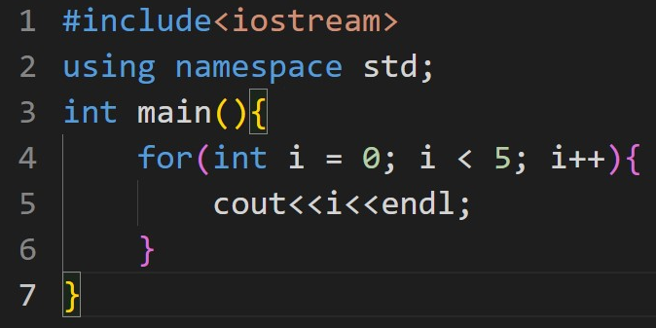
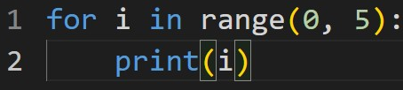
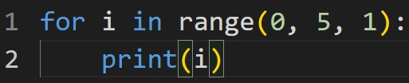
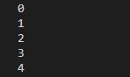
Python for loop – 01 - Increasing
13

Slide 15
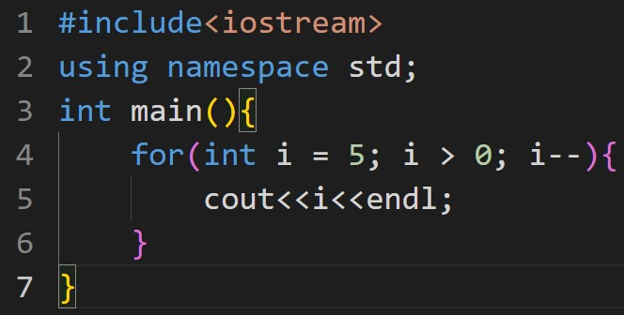
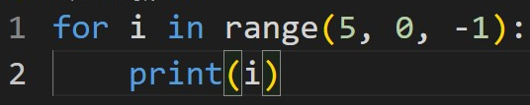
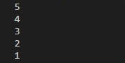
Python for loop – 02 – Decreasing(i)
14

Slide 16
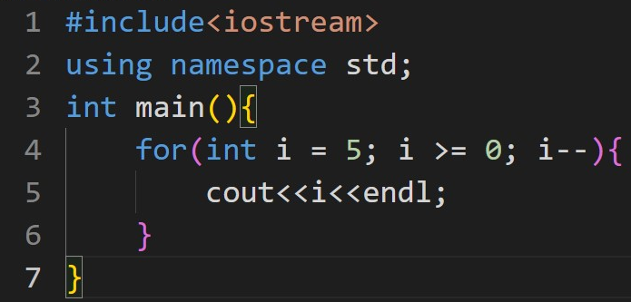
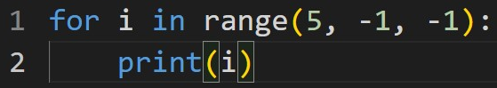
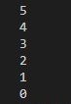
Python for loop – 03 – Decreasing(ii)
15

Slide 17
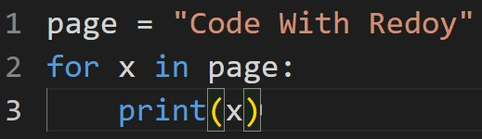
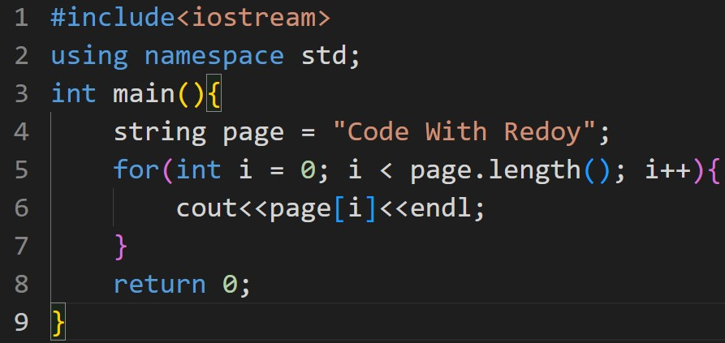
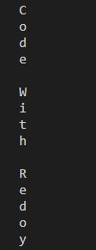
Python for loop – 03 – [Array Concept]
16

Slide 18
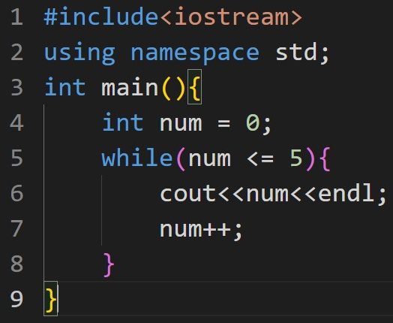
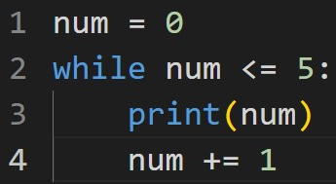
Python while loop
17

Slide 19
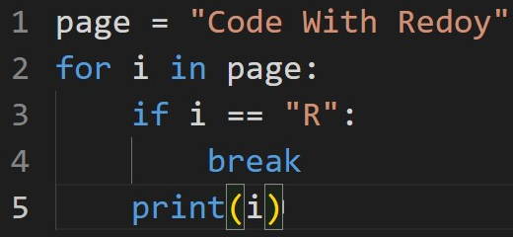
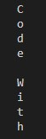
Python Break Statement
18

Slide 20
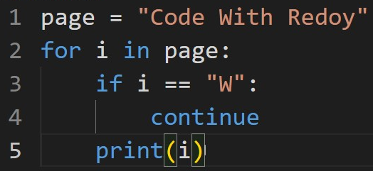
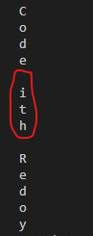
Python Continue Statement
19

Slide 21
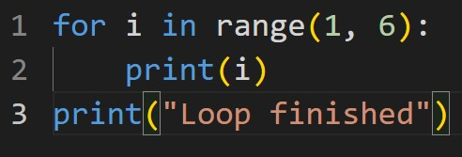
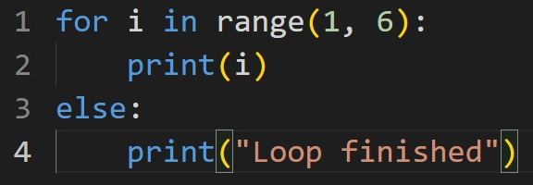
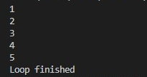
Python loop with Else Statement - 01
20

Slide 22
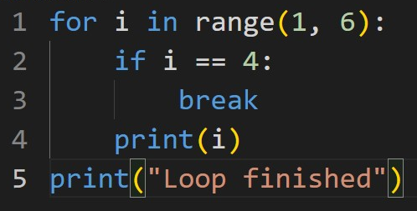
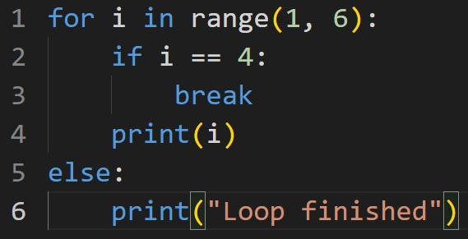
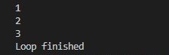
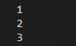
Python loop with Else Statement - 02
21

Slide 23
Practice Problem – 5.20
22
1
Write a program to Print your name 20 times using one printf
9
Write a program to print all alphabets from a to z
2
Write a program to Calculate Sum of Natural Numbers
10
Write a program to find last digit of a given number
3
Write a program to Calculate Sum of 1 to 10 numbers
Write a program to print all natural numbers in reverse (from n to 1)
11
4
Write a program to Generate Multiplication Table
12
Write a program to print all alphabets from a to z
5
Write an infinite loop. An infinite loop never ends. Condition is always true
13
Write a program to find last digit of a given number
6
14
Write a program to find first digit of a given number.
Write a program to print Even numbers up to N
7
15
Write a program to count number of digits in a number
Write a program to print odd numbers up to N
8
Write a program to print all natural numbers in reverse (from n to 1)
16
Write a program to check whether a number is palindrome or not

Slide 24
Practice Problem – 5.20
23
17
1 + 3 + 5 + 7 + 9 + 11 + 13 + 15 = ?
18
1 + 3 + 4 + 5 + 6 + 7 + …… + N
19
2 + 4 + 6 + 8 + 10 + 12 + 14 + ………………………… + N = ?
Write a program to find greatest common divisor (GCD) and least common multiple (LCM) of given two numbers.
20

Slide 25

24
Assignment of Week - 02

